Slide 1


Slide 2


Slide 3


Slide 4


Slide 5

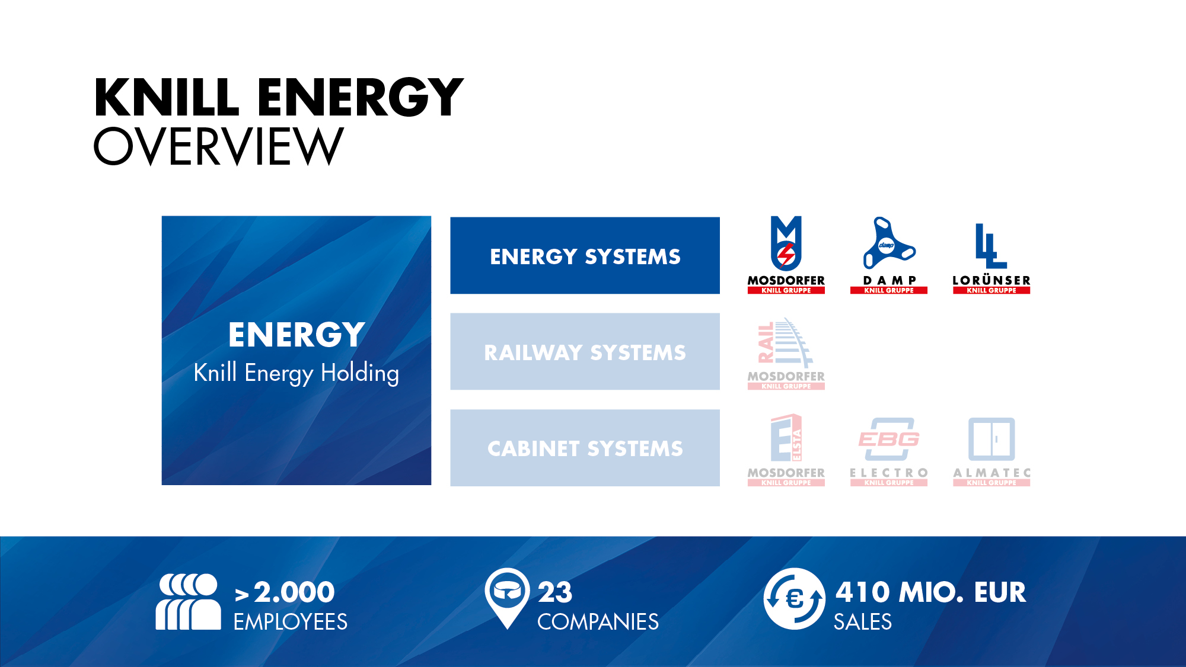

Slide 6



Slide 7


Slide 8


Slide 9


Slide 10


Slide 11


Slide 12


Slide 13
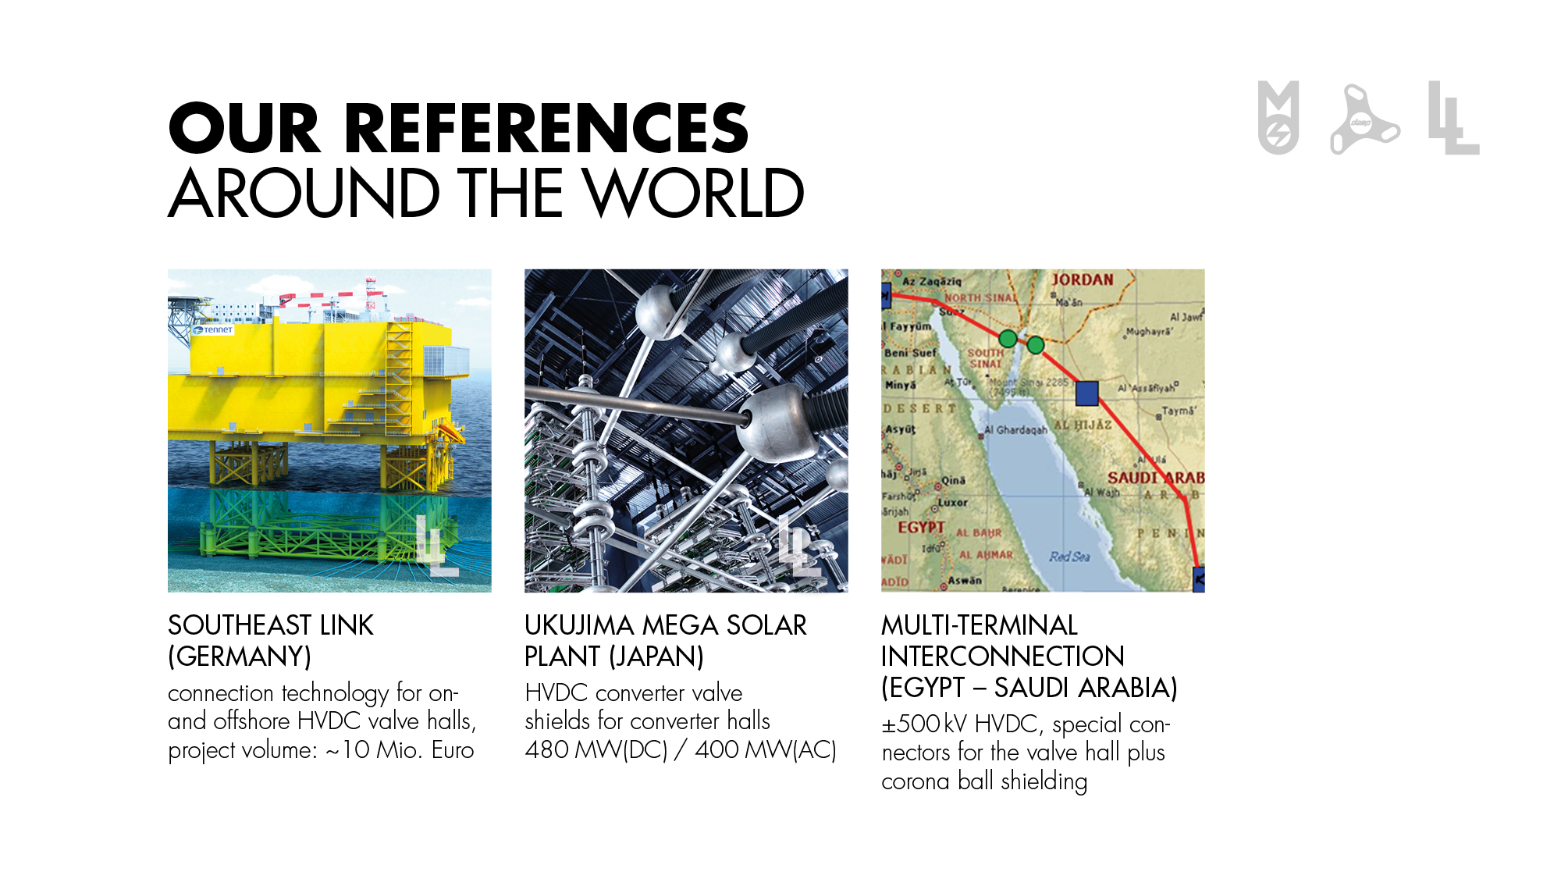

Slide 14


Slide 15


Slide 16


Slide 17


Slide 18
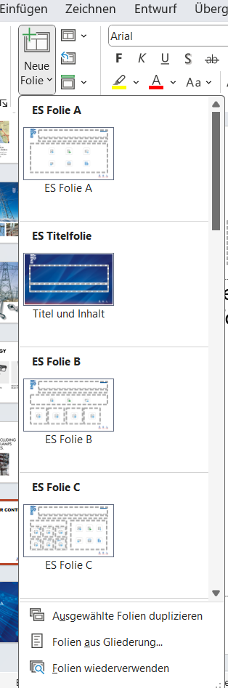
Space for your content
Use the available format layouts to add
your details and info to this general presentation

Slide 19


